Slide 1


What is Neighborhood Watch?
San Mateo Police Department

Slide 2
Overview of Presentation
Introductions of Key Personnel
What is Neighborhood Watch?
Block Captain(s) Roles & Responsibilities
Crime Statistics
Stay Connected

Slide 3
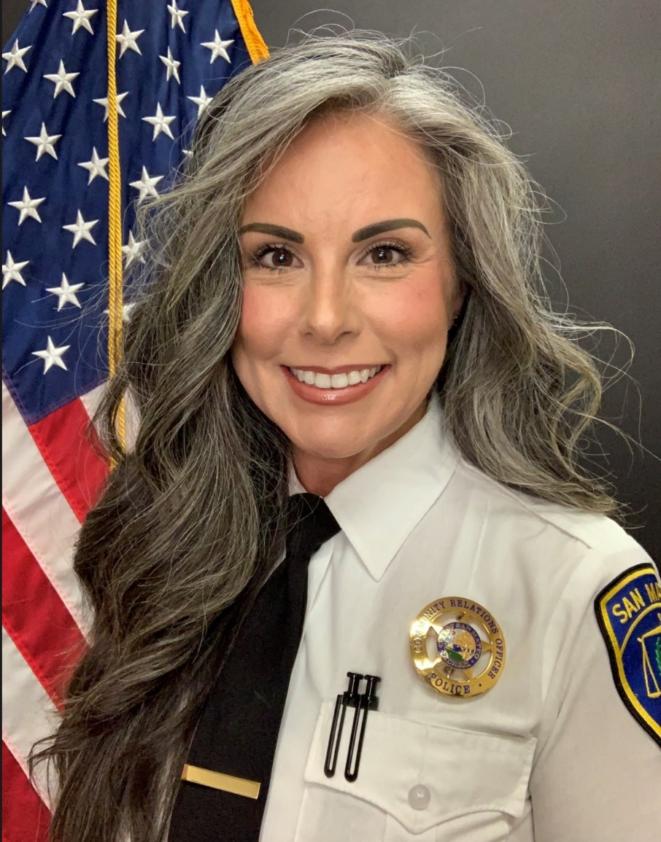
Community Relations Officer, Neighborhood Watch Program Coordinator
Jeanine Luna
jluna@cityofsanmateo.org
(650)522-7722

Slide 4
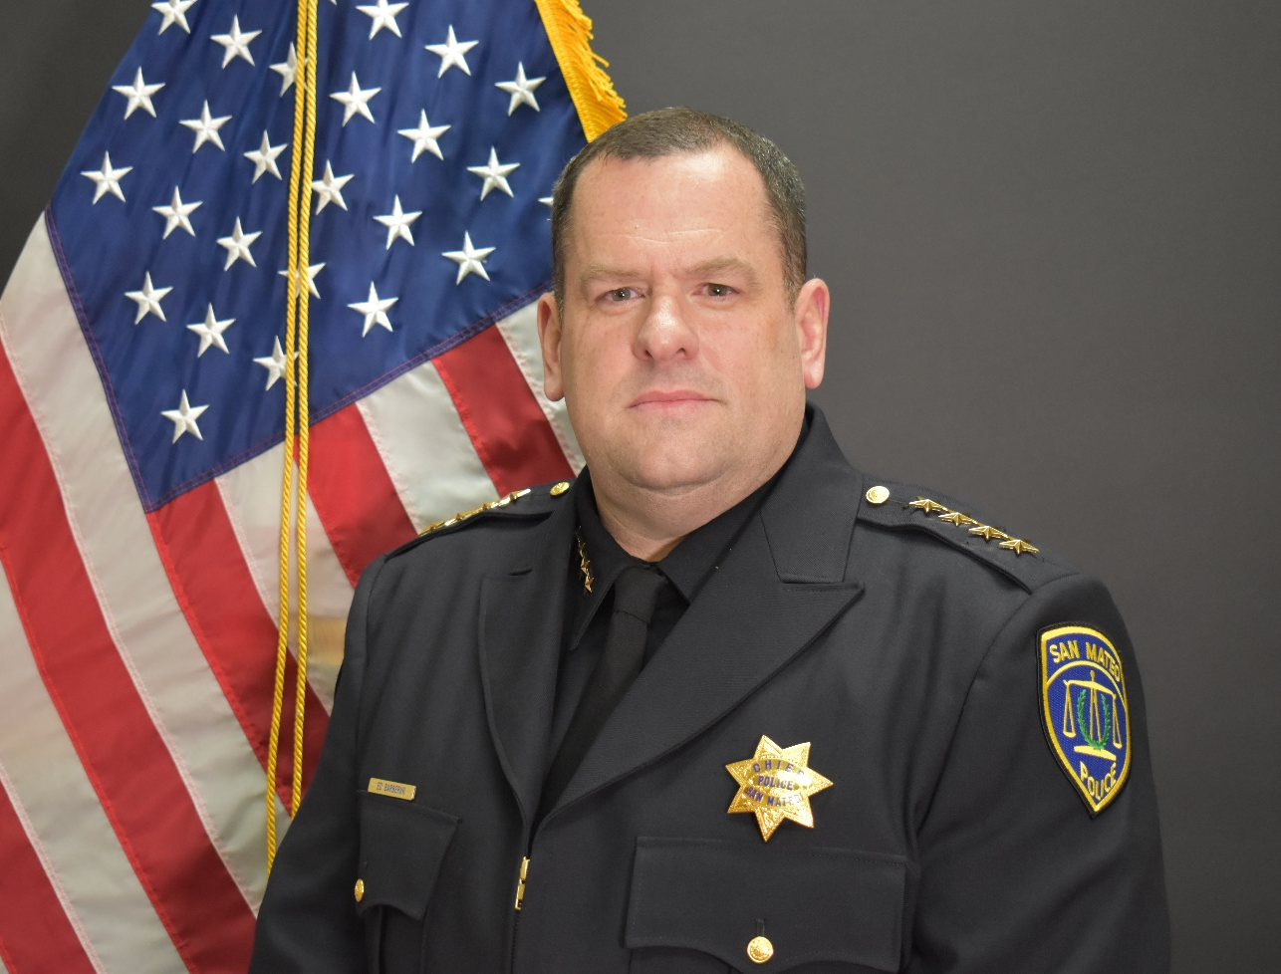
San Mateo Chief of Police
Ed Barberini

Slide 5
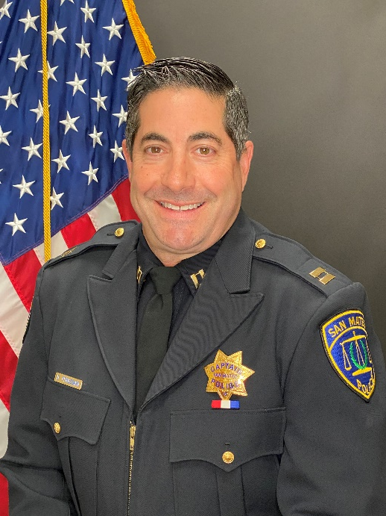
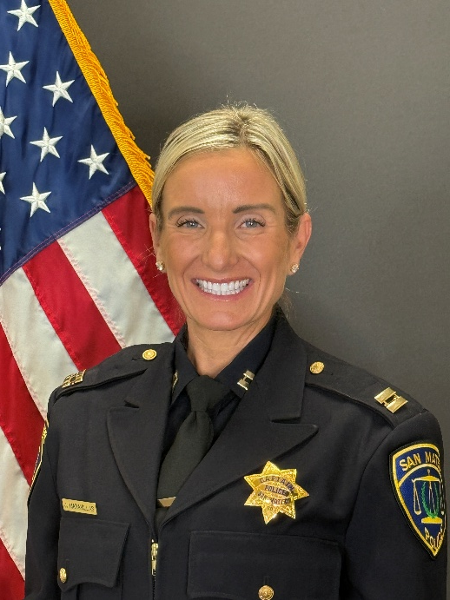
Police Captains
Dave Peruzzaro
Field Operations
Jen Maravillas
Support Services

Slide 6
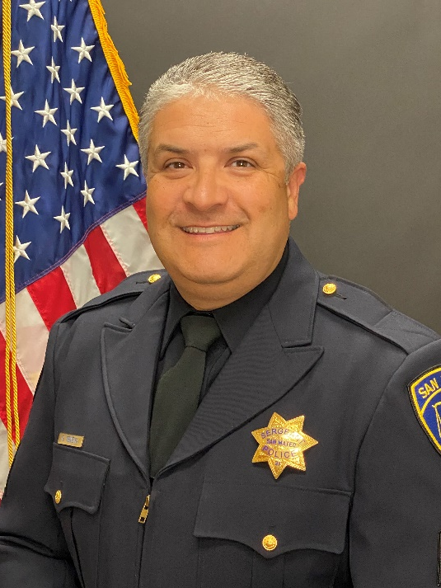
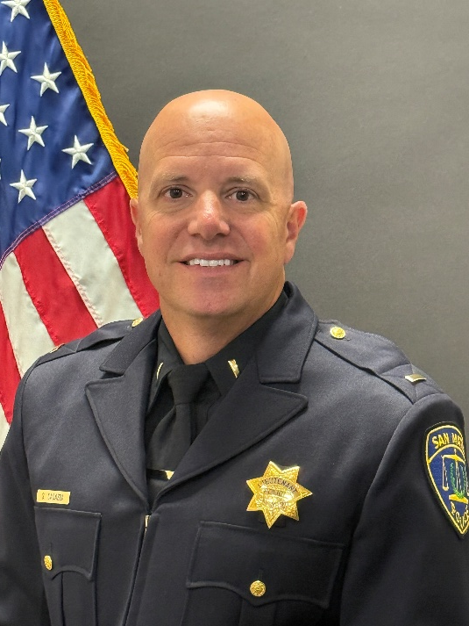
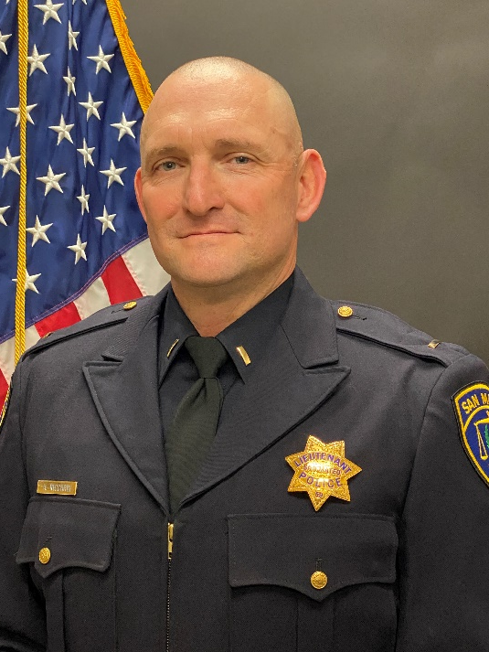
Area Lieutenant
Area 3 (SM East of HWY 101 & Downtown)
Lt. Anthony Riccardi #L59
ariccardi@cityofsanmateo.org
(650)522-7689
Area 1 (N. SM to HWY 92)
Lt. Glen Teixeira #L31
gteixeira@cityofsanmateo.org
(650)522-7608
Area 2 (HWY 92 to S. SM)
Lt. Steve Casazza #L48
scasazza@cityofsanmateo.org
(650)522-7663

Slide 7
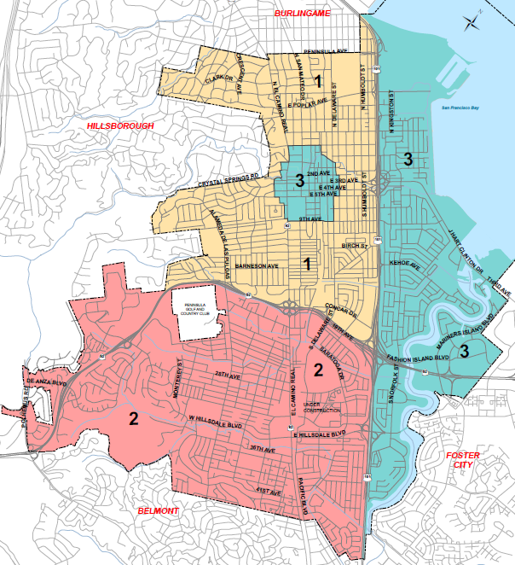
Area Map
Lt. Teixeira
Lt. Riccardi
Lt. Casazza

Slide 8
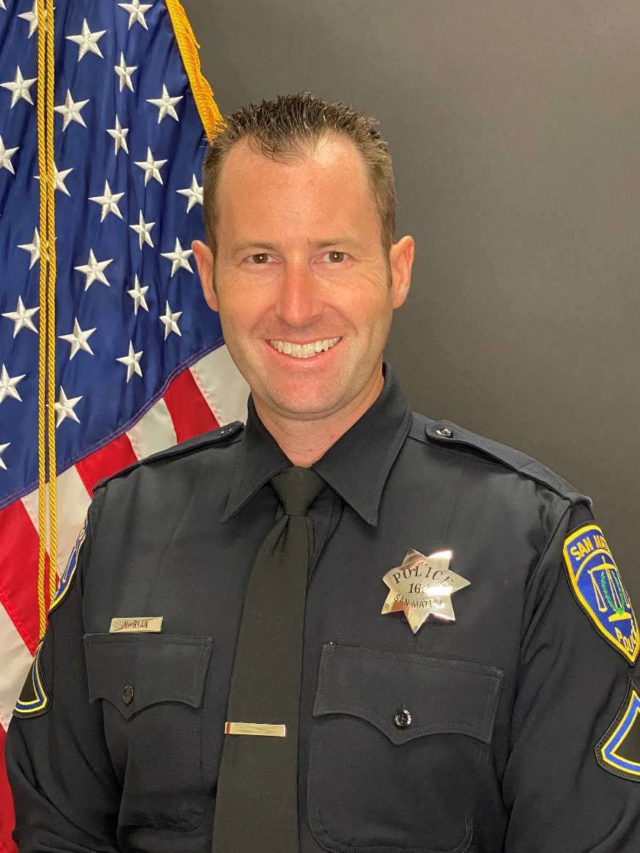
Traffic Sergeant
Nick Ryan
Sgt. Ryan: (650)522-7742
nryan@cityofsanmateo.org
For traffic enforcement, email:
traffic@cityofsanmateo.org

Slide 9
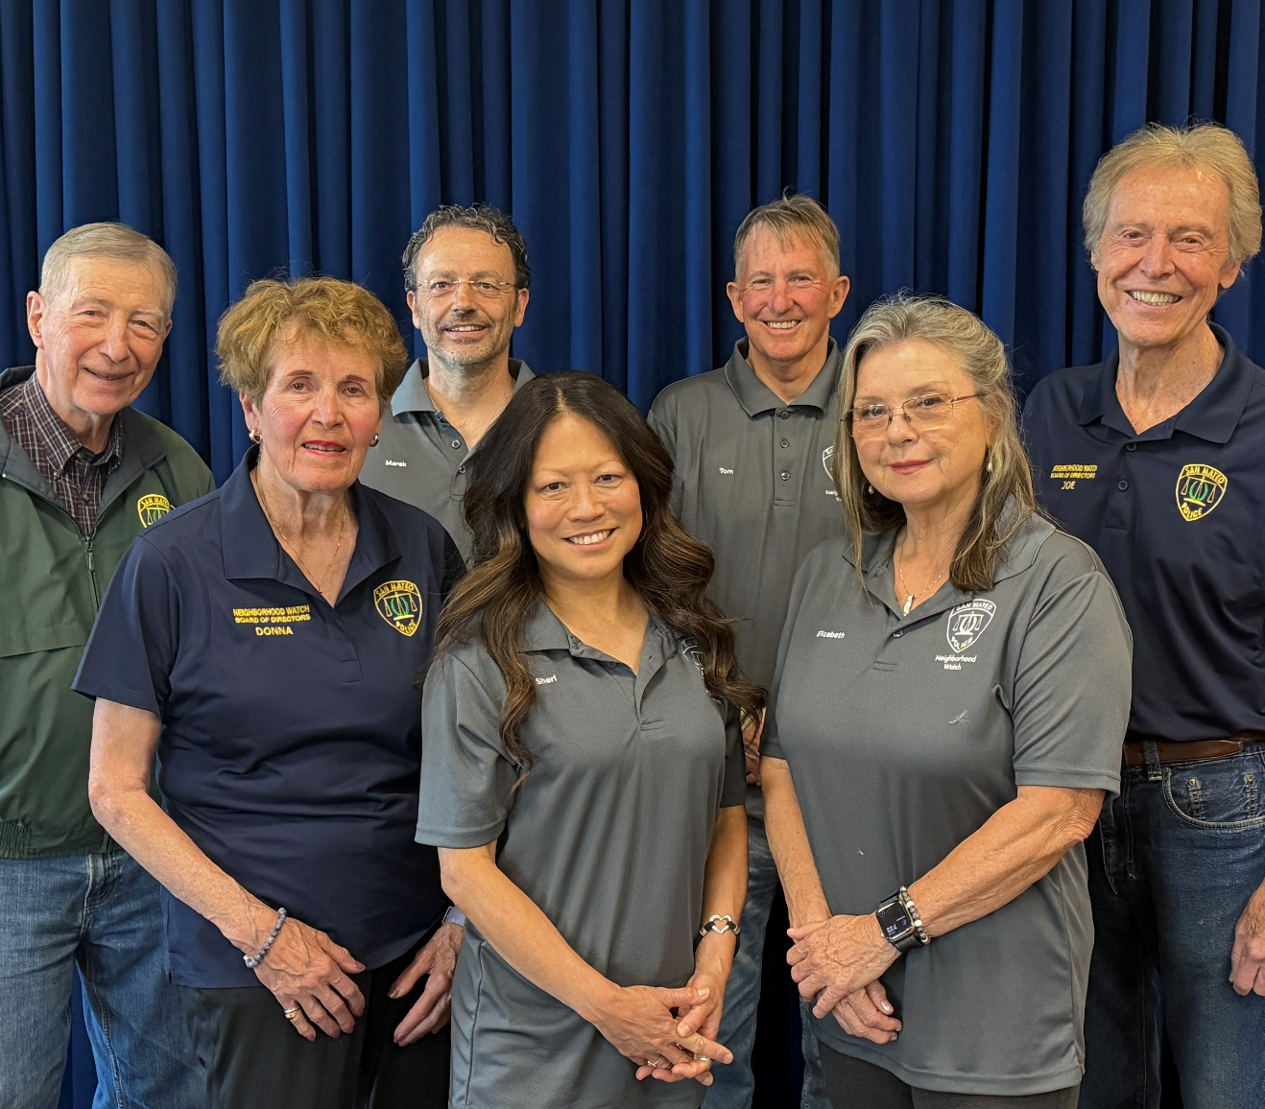
Neighborhood Watch Board of Directors
*Pictured: Rich Hedges, Donna Divodi, Marek Wolter, Sheri Boles, Tom Lease, Elizabeth Barton, and Joe Gershaneck.

Slide 10
Neighborhood Watch Board of Directors
Area 1
-Marek Wolter
-Taso Zografos
Area 2
-Elizabeth Barton
-Sheri Boles
-Tom Lease
-Victor Luscap
Area 3
-Donna Divodi
-Joe Gershaneck
-Rich Hedges
-Rick Sakuda
Burlingame border south to HWY 92, west of HWY 101
HWY 92 south to the Belmont border, west of HWY 101
Entire east side, east of HWY 101

Slide 11
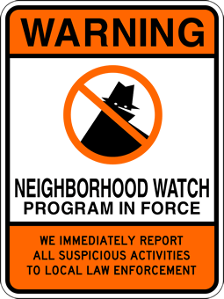
What is Neighborhood Watch
A Crime Prevention Program that enlists resident participation in a police-community collaborative battle against neighborhood crime
Our primary purpose is personal and property protection for neighborhoods & residents by knowing your neighbors and working together in a program of mutual assistance
It is an extension of the “eyes & ears” of the Police Department and about crime prevention education and implementation of important home and personal security strategies
Governed by the Police Department and a Board of Directors, with the assistance of Block Captains

Slide 12
Block Captains
Roles & Responsibilities

Slide 13
Block Captain Responsibilities
Organize your block. To be a recognized Neighborhood Watch Block, there needs to be a Block Captain.
Keep a roster of contact information for residents.
Know your neighbors! Meet current residents and welcome new ones.
Attend and/or host neighborhood/community meetings & events. Encourage block participation.
Actively promote the ideals of Neighborhood Watch.
Provide neighbors with information and resources provided by the Police Department.

Slide 14
What is a Block Captain?
A volunteer
A conduit to receive and relay information to and from neighbors to and from the Police Department
A point person for their block to foster the benefits of Neighborhood Watch
Provide safety & security information and advice on defensive measures and to provide advice on what to report

Slide 15
A Block Captain is NOT…
Law Enforcement
A vigilante
An authority in a criminal situation
Authorized or encouraged to become physically involved in a crime in progress
Responsible for handling neighborhood complaints

Slide 16
Time Commitment
Minimal and as needed
If your neighborhood requests a presentation from the Police Department
When contact information changes or you move
When you receive content from the PD worthy of sharing with neighbors
If SMPD asks you to physically deliver materials to residents on your block(s)
During National Night Out – first Tuesday in August annually (“America’s Night Out Against Crime”)
Encourage some type of block/resident get-together in your area (Registered blocks get PD visit, et al.)
PD hosts single, public event at King Center for those not organizing an event

Slide 17

Your involvement will directly affect the
crime rate of your neighborhoods!
CRIME
On average, Neighborhood Watch Blocks are 84% safer than non-Neighborhood Watch Blocks
Attributed to appearing “occupied”, meaning your neighborhoods look “lived in”, people coming and going, knowing what’s going on and who belongs; therefore, creating a riskier environment for crooks to target
Areas with the highest crime rates are the most reluctant to organize, making them target fresh
“SEE SOMETHING, SAY SOMETHING!”

Slide 18
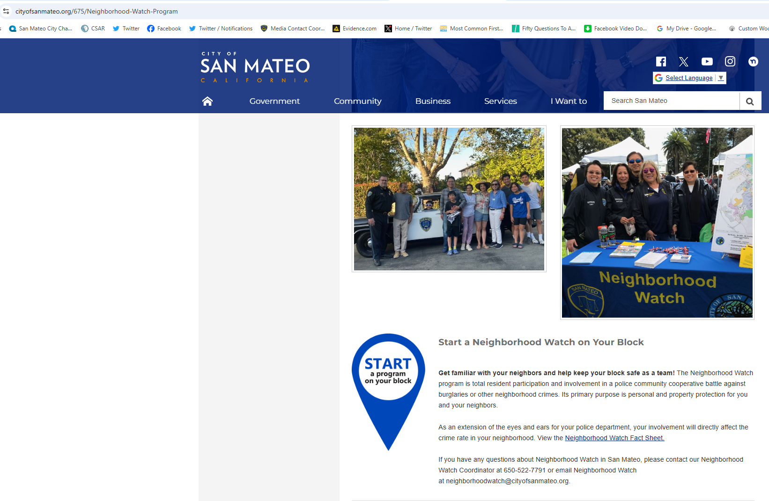
https://www.cityofsanmateo.org/675/Neighborhood-Watch-Program

Slide 19
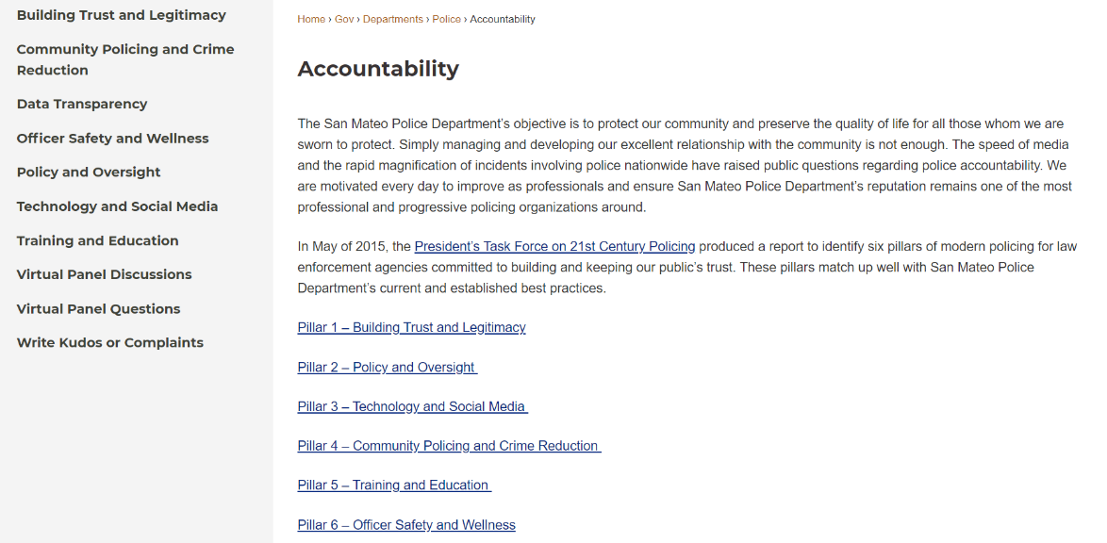
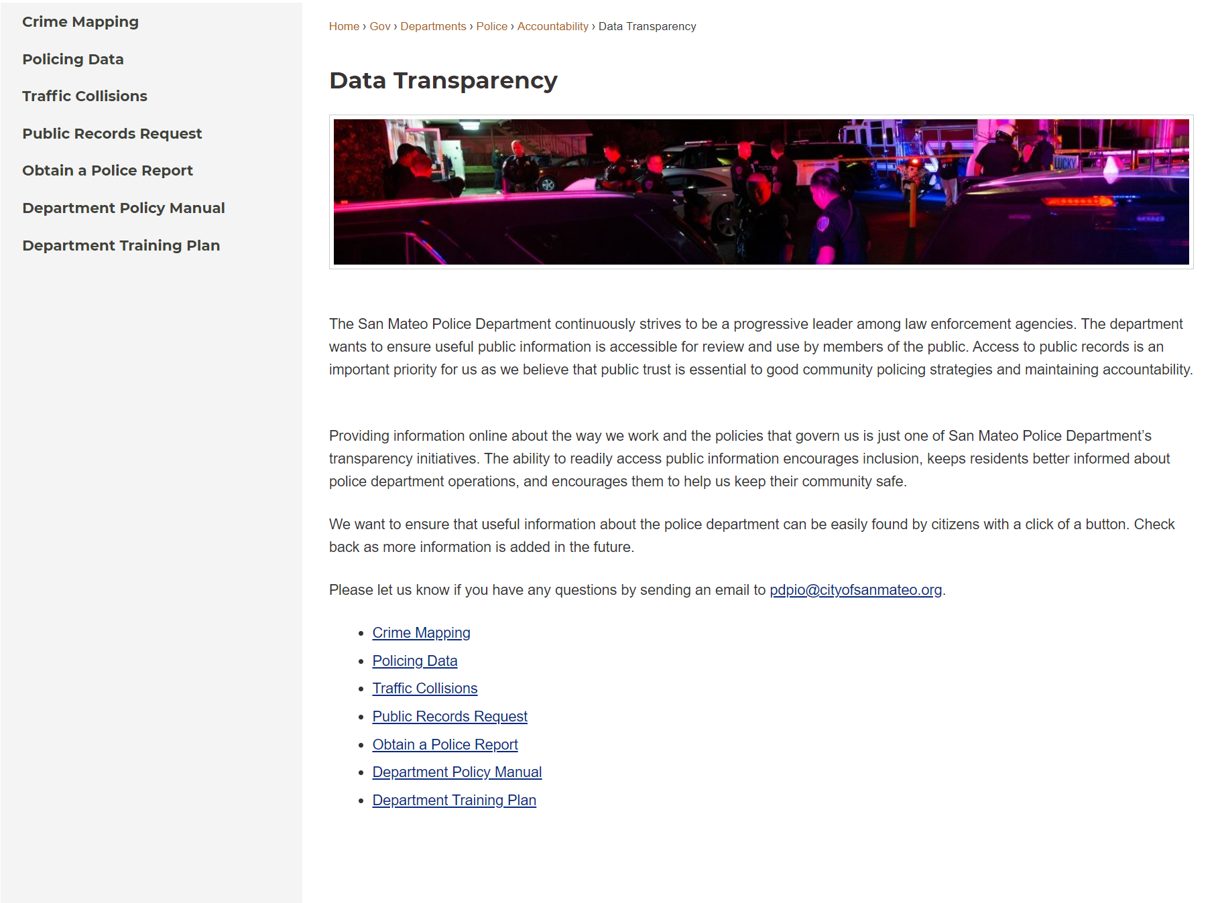
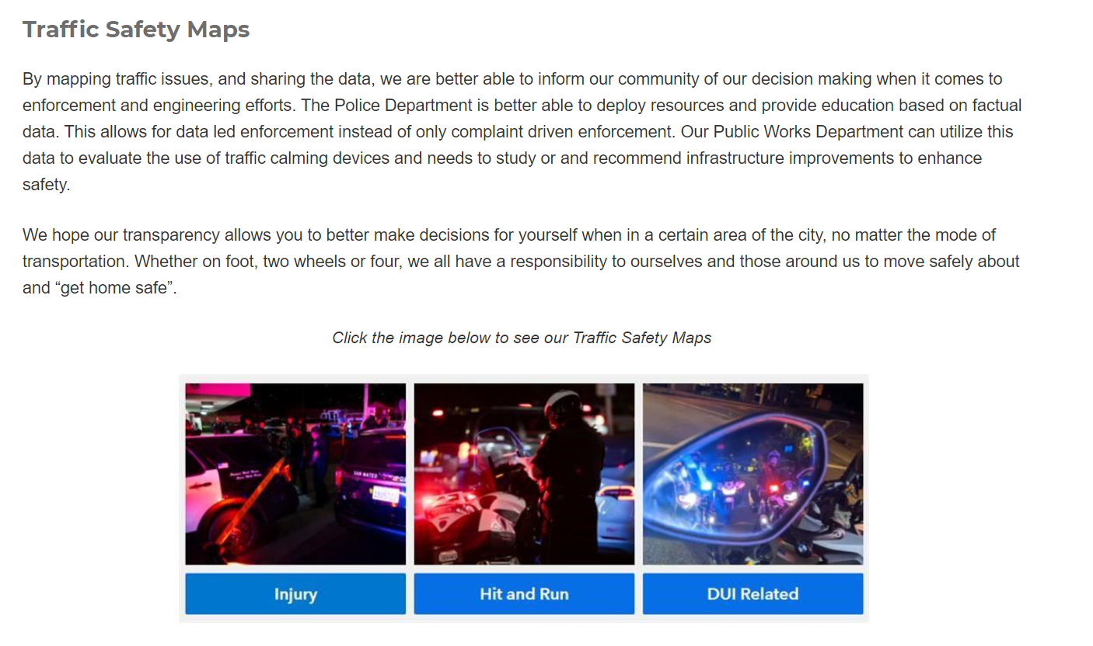
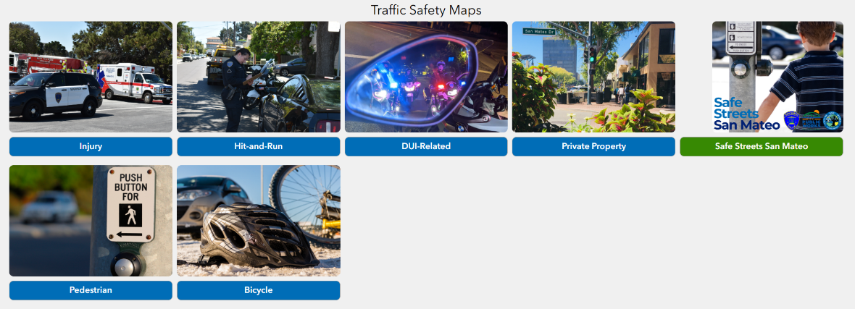
Data Transparency Web Page
https://www.cityofsanmateo.org/4451/Data-Transparency
Police Accountability Web Page
https://www.cityofsanmateo.org/4331/Accountability
Traffic
https://experience.arcgis.com/experience/8a9f7321d1ce46ffbc0e1f04757efb5f/

Slide 20
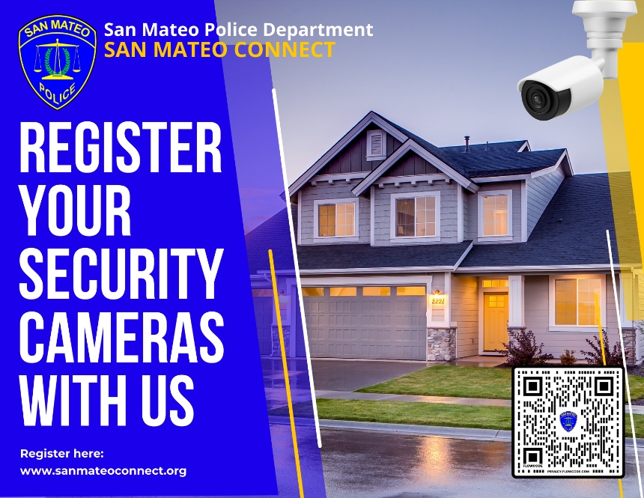
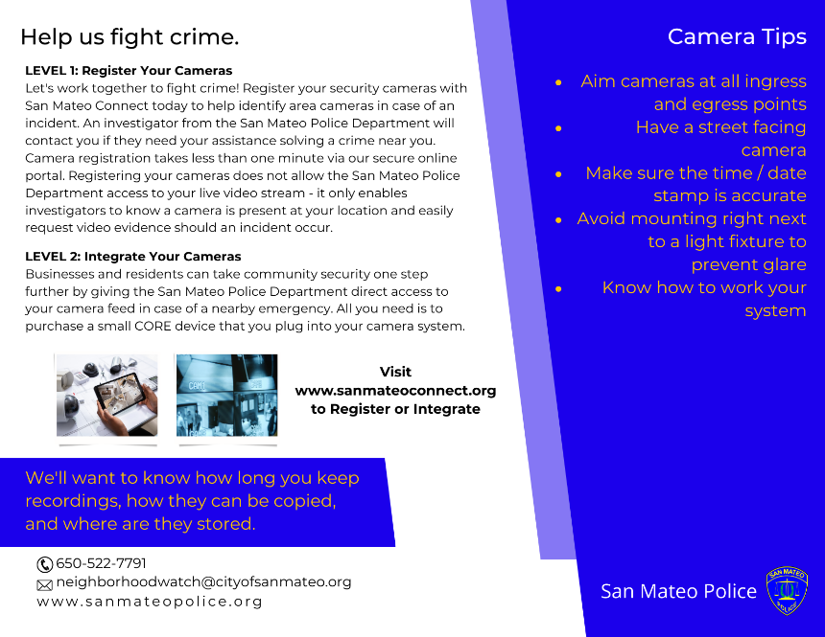
San Mateo Connect (Home & Business Security Camera Registry)
This voluntary registry informs the PD of the locations of home security cameras in the city. We do not have access, remote or otherwise, to your personal property. This simply aids the PD in locating potential video evidence in the event an incident occurs in a residential neighborhood.
Register your Security Cameras at www.sanmateoconnect.org

Slide 21
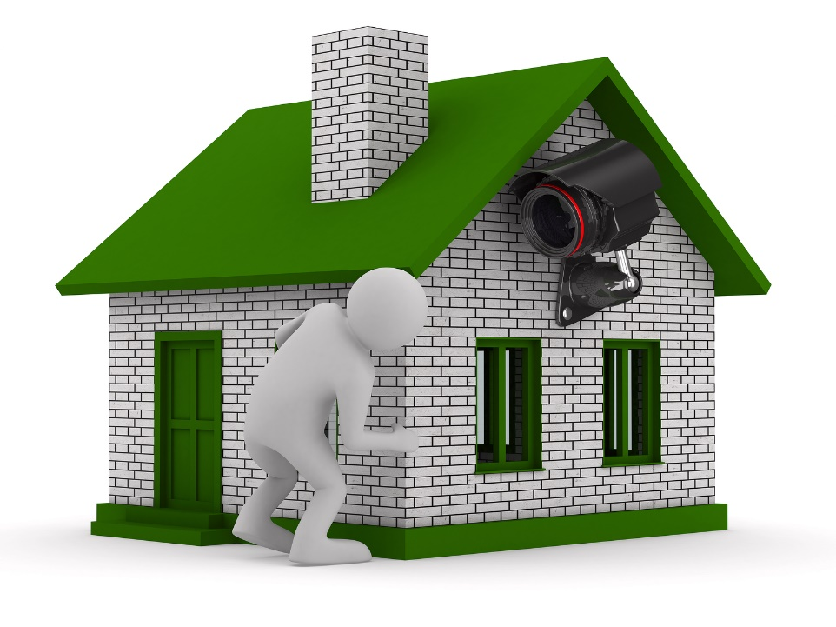
San Mateo CPTED (Crime Prevention Through Environmental Design)
CPTED is an approach to crime prevention that aims to reduce victimization, deter criminals, and build a sense of community by focusing on the hardening of one’s target; in this case, your home.
We do this by looking at things like access, territorial reinforcement, natural surveillance, and maintenance. Examples of these would be lighting, landscaping, security systems, barriers, and the community approach of “if you see something, say something.”
Contact Jeanine Luna for a basic CPTED evaluation of the exterior of your home, or to learn more.
jluna@cityofsanmateo.org

Slide 22
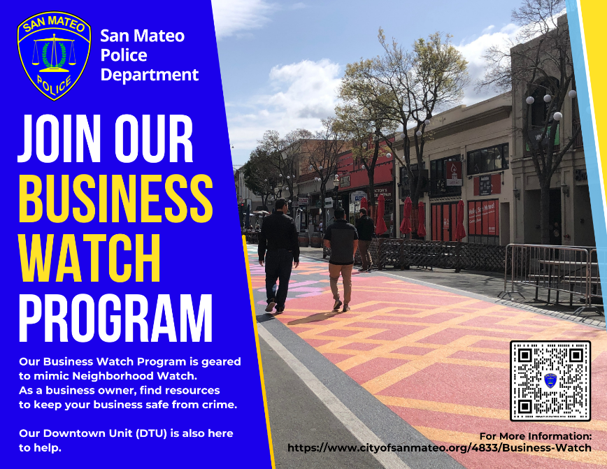
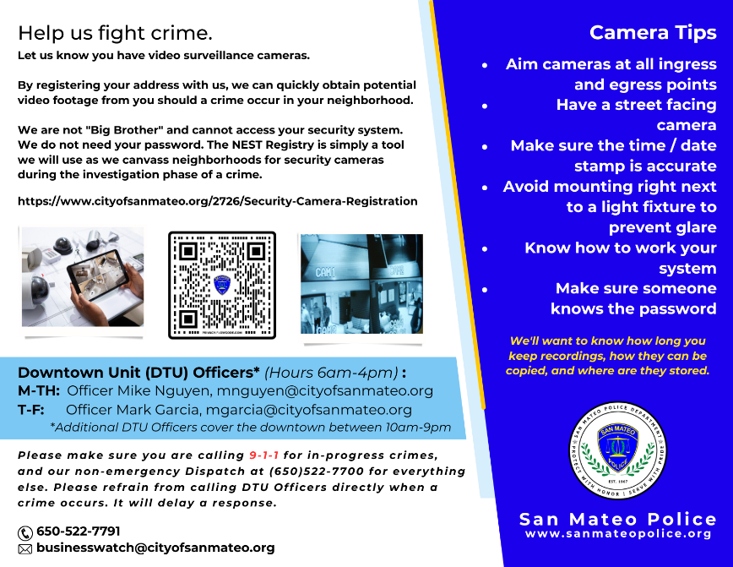
San Mateo Business Watch
Neighborhood Watch for Businesses
Looking to build partnerships, provide education & training, share information, and foster community engagement. Ultimately, looking to garner real time information to fight crime as it’s happening.
https://www.cityofsanmateo.org/4833/Business-Watch

Slide 23
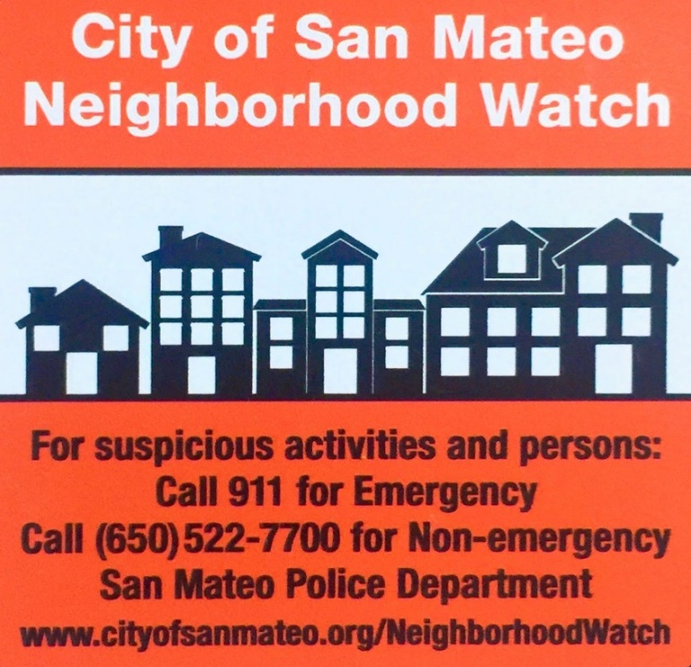
TIPS TO MAKE IT EASIER!
Stay Connected with the PD
Follow us on all of our Social Media and Alert platforms (see next page)
Contact us at:
neighborhoodwatch@cityofsanmateo.org
(650)522-7791
Keep a Block Roster with Contact Info
Be a Good Witness
Be a Nextdoor Ambassador for your Community
The PD can not view any posts and/or comments on posts we did not generate, so please encourage police reporting when appropriate.

Slide 24
Stay Connected
Follow us on our Social Media & Alert Platforms
Social Media
X (@SanMateoPD)
Facebook (@CityofSanMateoPD)
Instagram (sanmateopd)
YouTube (San Mateo Police Department)
Alert & Communication Platforms
Nextdoor.com (Neighborhood Social Media)
Nixle (Critical text and email alerts)
-Text your zip code to 888777 or visit nixle.com/san-mateo-ca-police-department
SMC Alert (County alerts)
-https://www.smcgov.org/dem/smc-alert
Make sure to follow our @SanMateoPDK9 pages and @SanMateoPAL pages too!

Slide 25
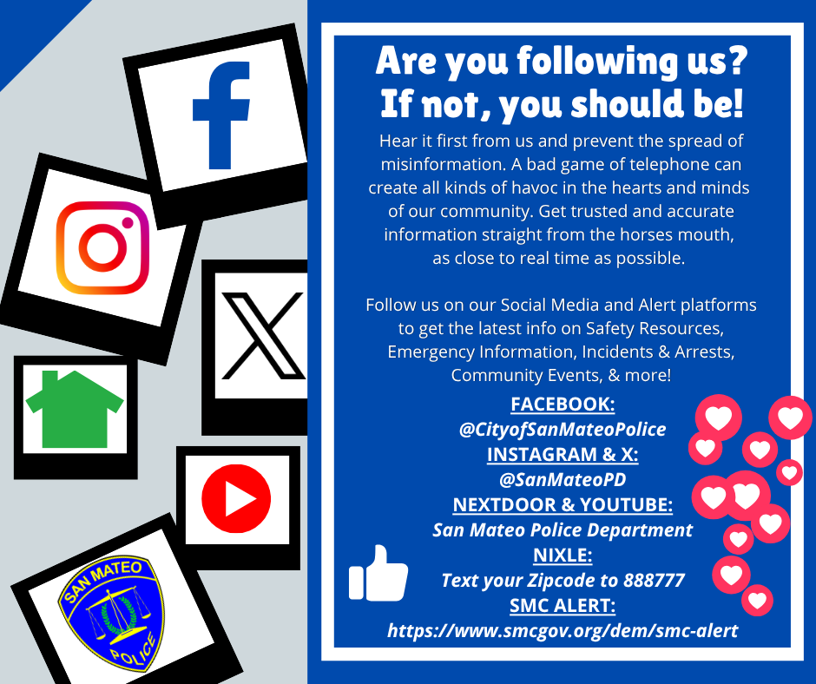

Slide 26
